Slide 1

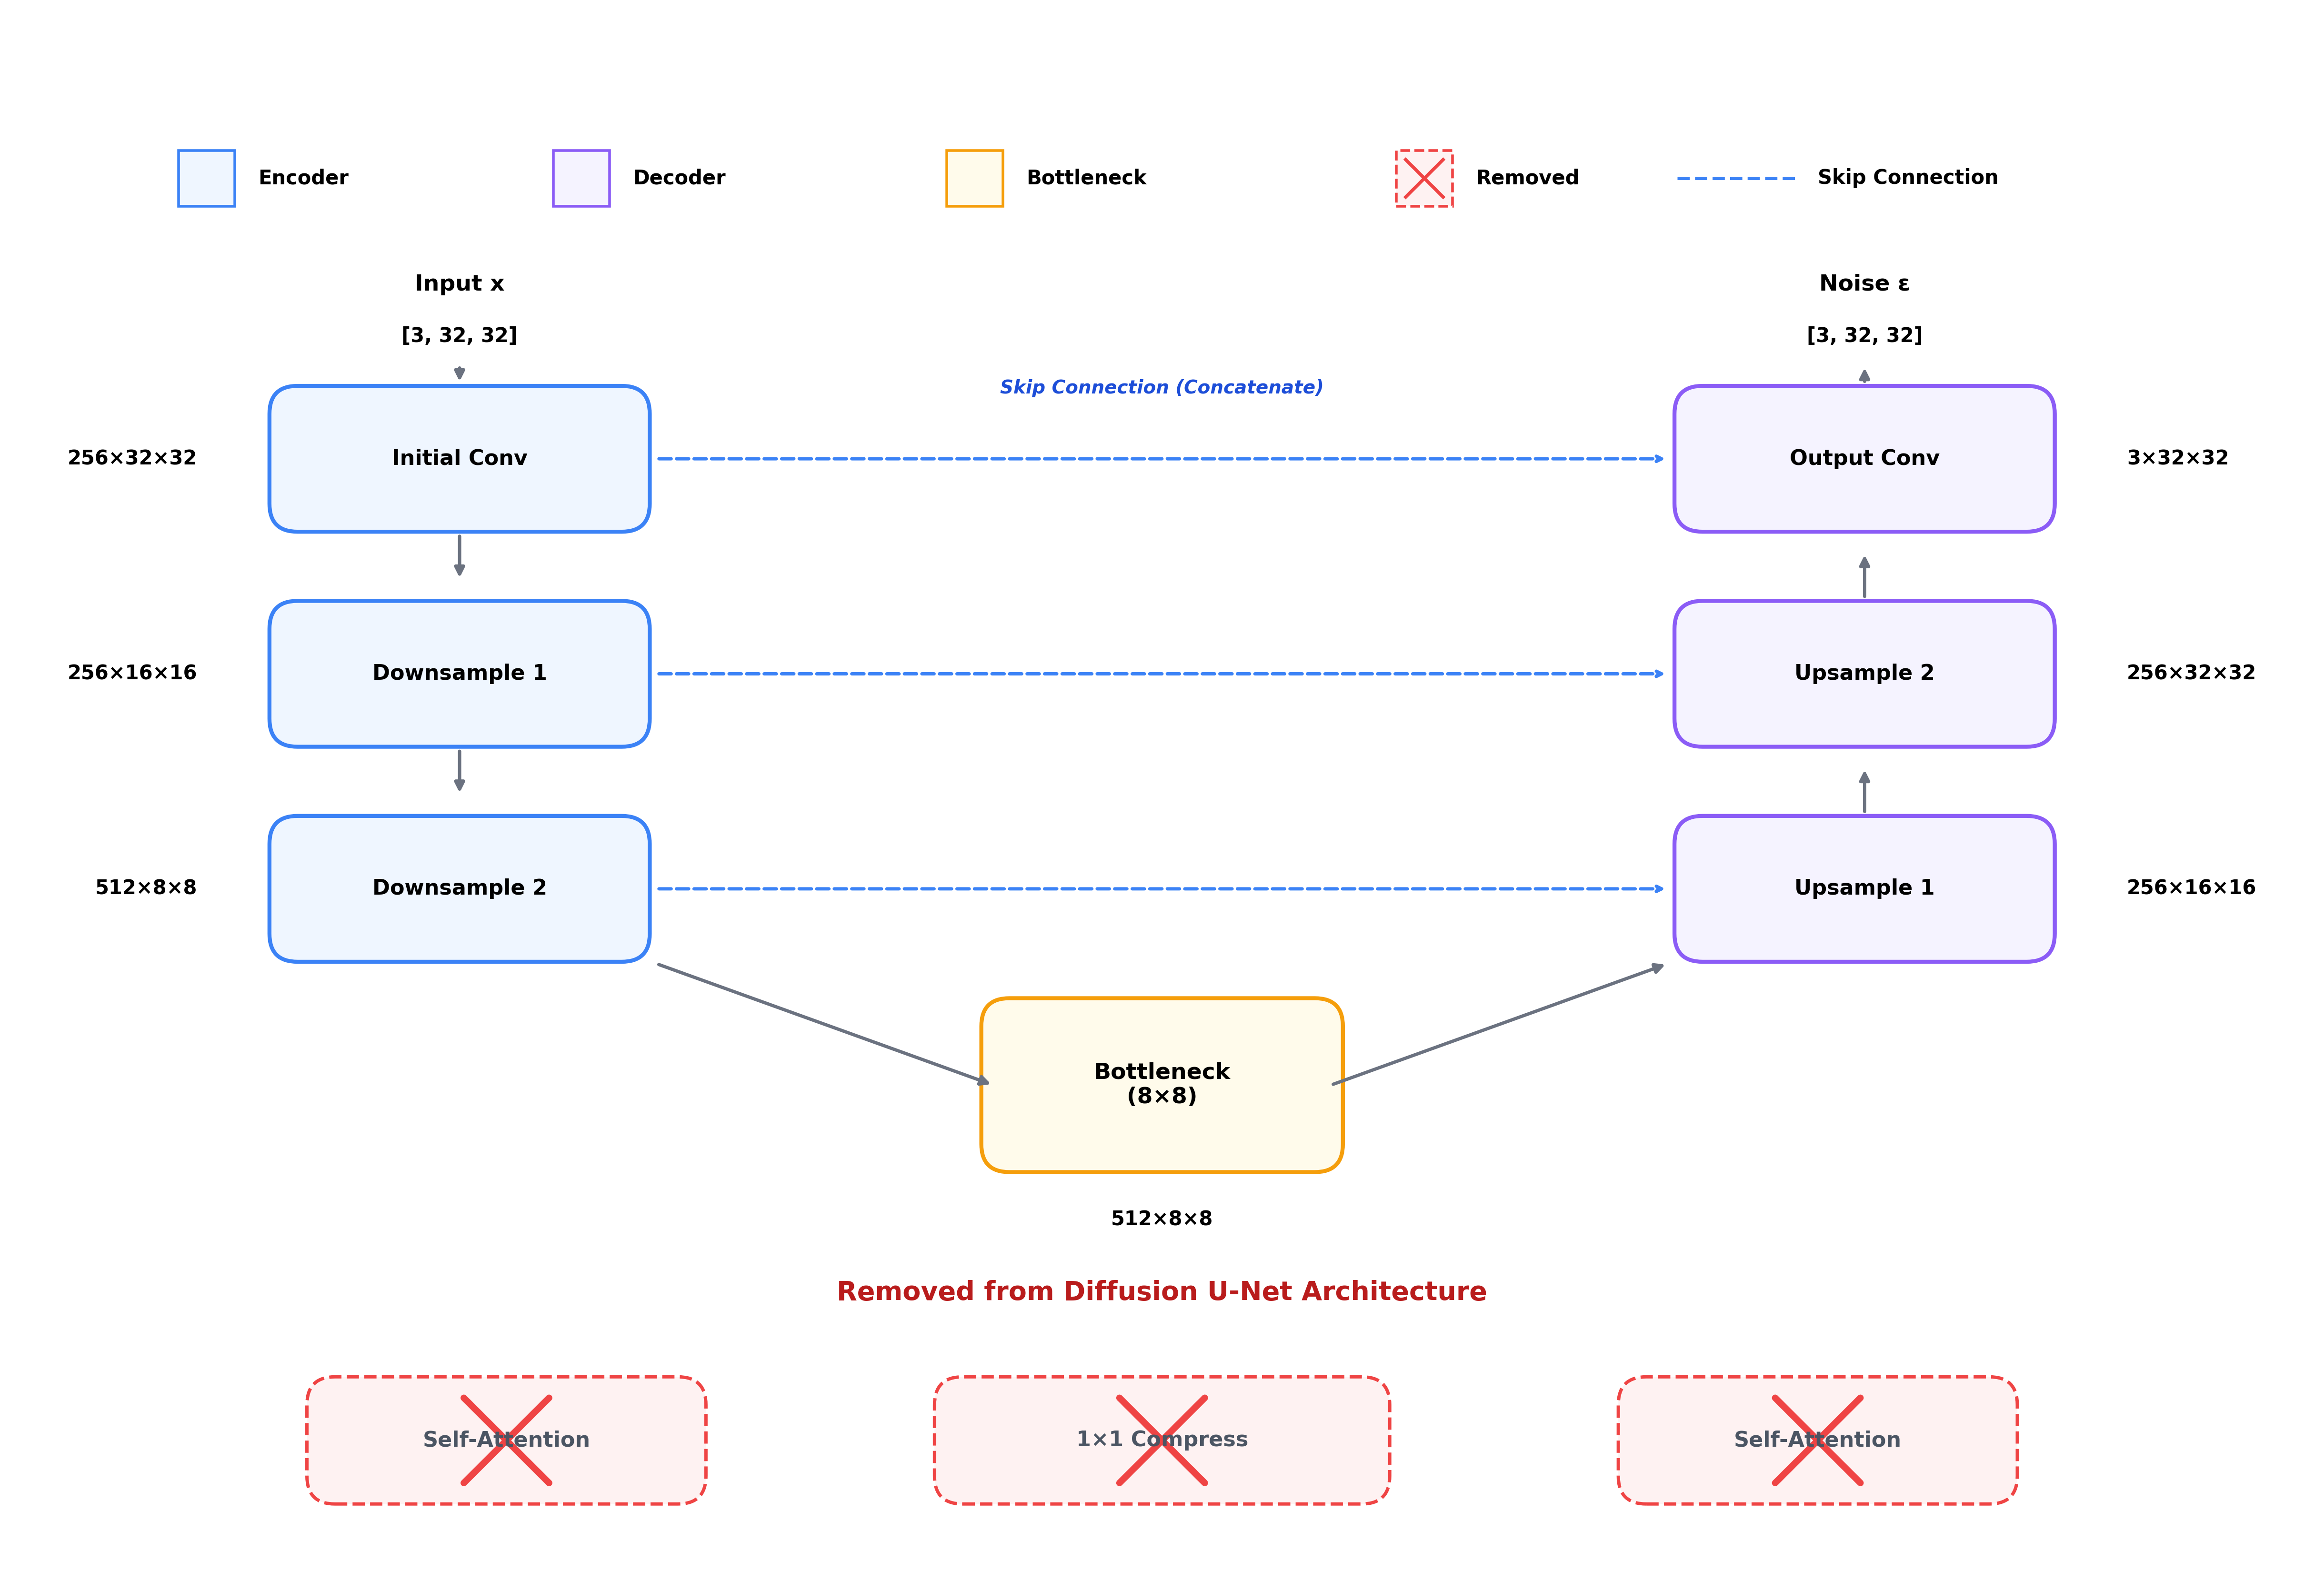
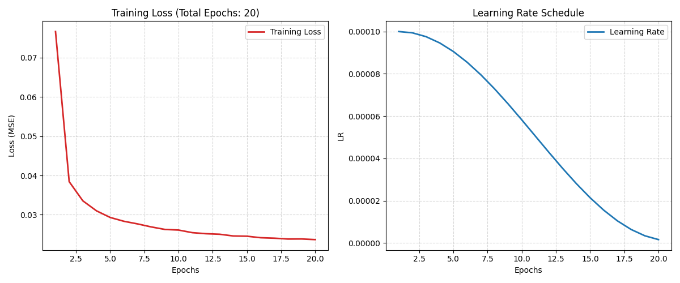

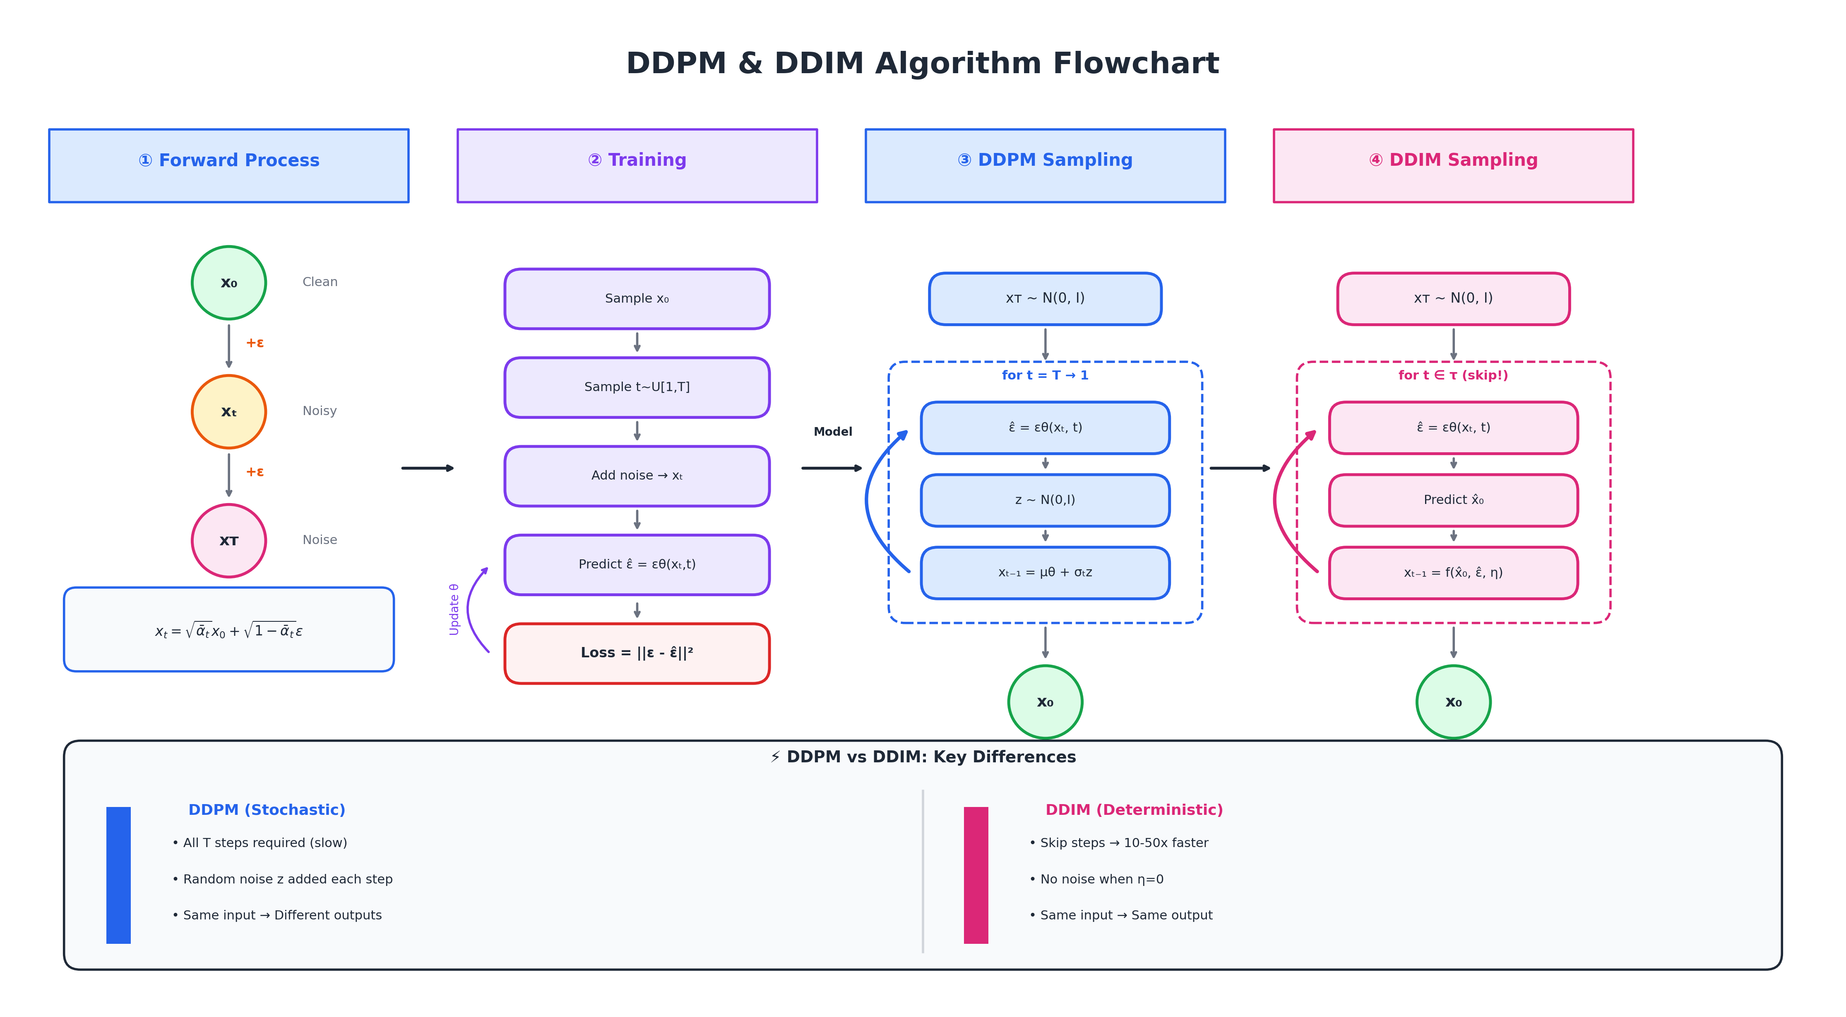
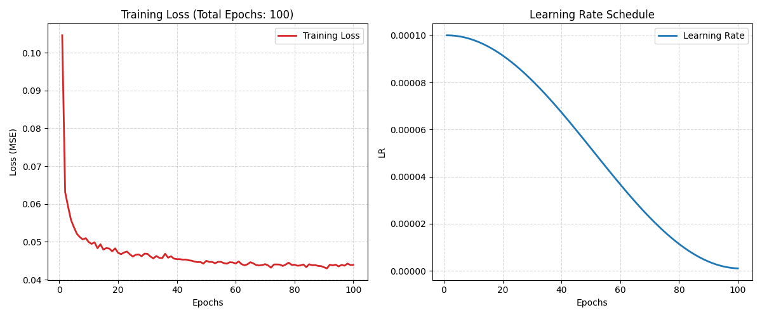
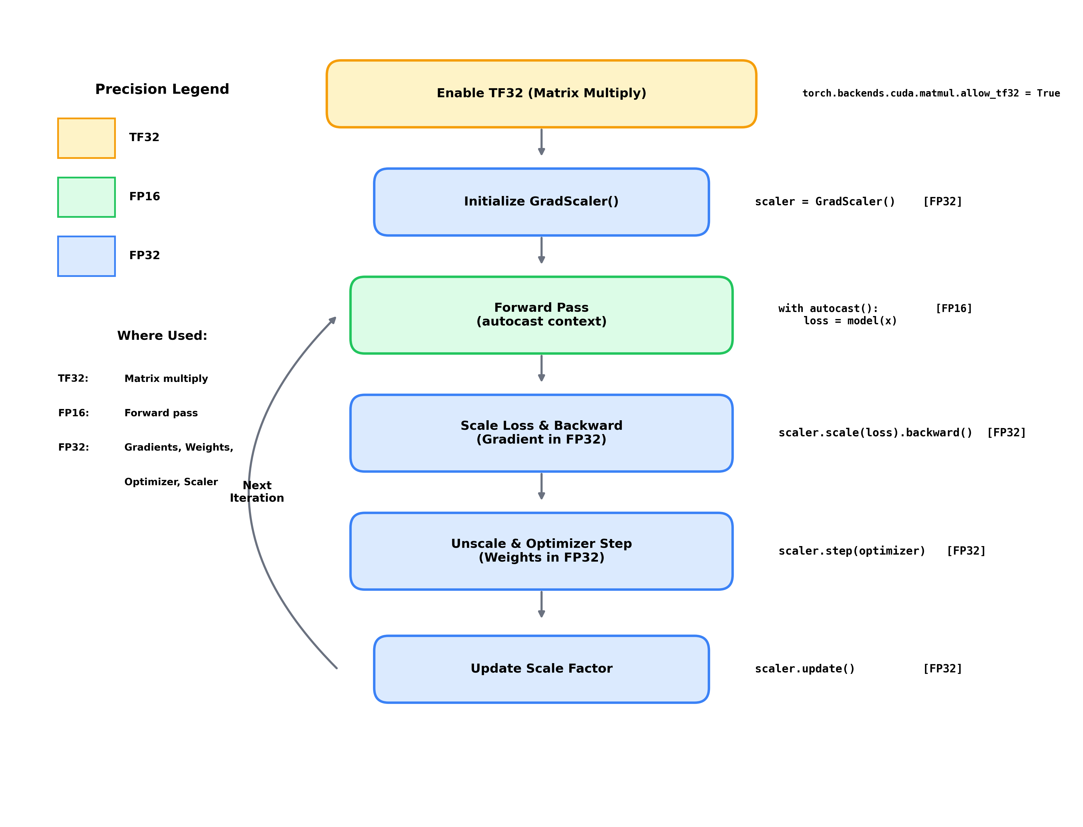


FastDiff: A Lightweight and Accelerated Diffusion Framework for Efficient Image-to-Image Generation
Jincheng Rao, Zihan Xiao
Project Overview - Purpose of FastDiff
Improved Structure
Training Behavior and Diffusion Reconstruction on MNIST and CIFAR-10
Diffusion models have become a leading approach for high-quality image generation by learning to reverse a gradual noising process. In this project, we propose FastDiff, a lightweight and accelerated diffusion framework tailored for efficient image-to-image generation. By improving both model architecture and sampling strategy, FastDiff aims to deliver strong visual quality with significantly reduced computational overhead.
Key Points:
Lightweight U-Net for reduced computational cost
Mixed-precision training (AMP) for 1.5–2× faster training
Accelerated sampling via DDIM with fewer reverse steps
Efficiency-focused design enabling faster image-to-image generation
Lightweight U-Net Architecture
Training Loss & Learning Rate Schedule on MNIST (20 Epochs)
Project Objectives
Build an FastDiff Training Pipeline
DDPM vs. DDIM
Forward and Reverse Diffusion Process on MNIST: The top row illustrates the gradual addition of noise to a clean digit, while the bottom row shows the DDPM reverse denoising steps recovering the original structure.
AnalyzeQuality–Efficiency Trade-offs
Explore extensions
Self-attention introduces $O\left(n^{2}\right)$computational cost, making it the primary bottleneck in diffusion U-Nets. Removing attention significantly reduces FLOPs(Floating Point Operations) and accelerates both training and sampling.
Training Loss & Learning Rate Schedule on CIFAR-10 (100 Epochs)
AMP (Automatic Mixed Precision) Training Flow
Forward and Reverse Diffusion Process on CIFAR-10: The top row shows the progressive corruption of a CIFAR-10 horse image, while the bottom row illustrates the reverse denoising steps reconstructing the original visual structure.
AMP accelerates training by combining TF32 (TensorFloat-32) for fast matrix operations, FP16 (Half Precision 16-bit Floating Point) for the forward pass, and FP32 (Full Precision 32-bit Floating Point) for gradient computation and optimization, enabling efficient yet numerically stable mixed-precision learning.
References
Ho, J., Jain, A., & Abbeel, P. (2020). “Denoising Diffusion Probabilistic Models”. In: NeurIPS 33.
Nichol, A. Q., & Dhariwal, P. (2021). “Improved Denoising Diffusion Probabilistic Models”. In:ICML 2021.
Dhariwal, P., & Nichol, A. (2021). Diffusion Models Beat GANs on Image Synthesis. In:NeurIPS 34.

